Slide 1

Addressing modes; Design of a basic computer. General register organization
Computer Organization and Architecture | Register Organization
Course: Computer Organization and Architecture | Chapter: Register Organization | Program: Bachelor of Engineering
DISCOVER · LEARN · EMPOWER
Notes:
Welcome everyone to today's lecture on Register Organization. We will focus specifically on how addressing modes determine data location and the design of a basic computer. This session is crucial for understanding how the CPU interacts with memory and registers. Let us begin our journey to Discover, Learn, and Empower.

Slide 2
Course Outcomes
SLIDE 2 / 10
Course Outcome
CO | BT LEVEL | DESCRIPTION
CO1 | BT3 | Apply number systems and digital logic to design basic digital circuits
CO2 | BT4 | Analyze register organization and instruction set architecture
CO3 | BT3 | Implement computer arithmetic algorithms and floating-point operations
CO4 | BT5 | Analyze memory hierarchy and input-output organization
CO5 | BT6 | Evaluate control unit design and pipelining performance
Chandigarh University
2 / 10
Notes:
Today's lecture is directly mapped to Course Outcome 2. You will learn to analyze how register organization supports the instruction set architecture. This involves understanding how different addressing modes affect the design of the basic computer. By the end, you will be able to evaluate these architectural choices critically.

Slide 3
Learning Objectives
SLIDE 3 / 10
Learning Outcomes
1
Analyze the function of various addressing modes in instruction execution
2
Evaluate the impact of addressing modes on memory access time
3
Design a basic computer structure with general register organization
4
Differentiate between immediate, direct, and indirect addressing techniques
5
Apply register organization concepts to solve instruction fetch problems
Chandigarh University
3 / 10
Notes:
By the end of this session, you will be able to analyze how addressing modes function during instruction execution. We will evaluate how these modes impact the overall memory access time of a system. You will also design a basic computer structure featuring a general register organization. Finally, we will differentiate between immediate, direct, and indirect addressing techniques through practical examples.

Slide 4
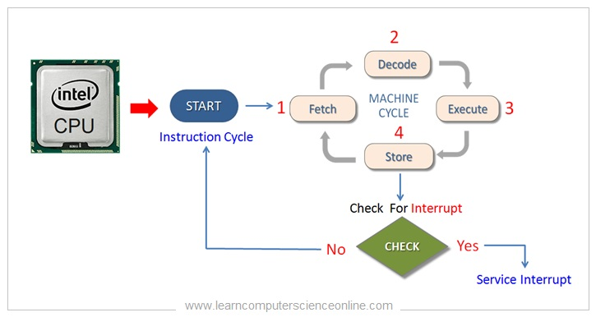
Lecture
SLIDE 4 / 10
Definition of Addressing Modes
1
Addressing modes define how the CPU calculates the effective address of an operand
2
The effective address determines the specific memory location or register containing data
3
Different modes offer trade-offs between instruction length and execution speed
4
Immediate mode places the operand directly within the instruction itself
5
Register mode uses a register number to specify the operand location
Instruction Cycle Explained | Fetch , Decode , Execute Cycle Step-By-Step
Chandigarh University
4 / 10
Notes:
Addressing modes define exactly how the CPU calculates the effective address of an operand. The effective address determines the specific memory location or register where the data resides. Different modes offer trade-offs between instruction length and execution speed. For instance, immediate mode places the operand directly within the instruction itself, saving a memory access.

Slide 5
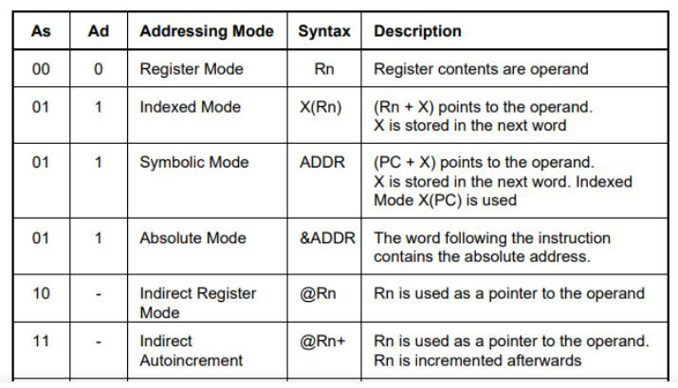
Lecture
SLIDE 5 / 10
Classification of Addressing Modes
1
Immediate addressing uses the operand value directly in the instruction field
2
Direct addressing specifies the memory address of the operand in the instruction
3
Indirect addressing uses a register or memory location to hold the address
4
Register addressing specifies a register number as the operand location
5
Indexed addressing adds an index register value to a base address
Source: cdn.hackaday.io
Chandigarh University
5 / 10
Notes:
We classify addressing modes based on how the operand is located. Immediate addressing uses the operand value directly in the instruction field. Direct addressing specifies the memory address of the operand in the instruction. Indirect addressing uses a register or memory location to hold the address, adding a level of indirection. Register addressing specifies a register number as the operand location for speed.

Slide 6
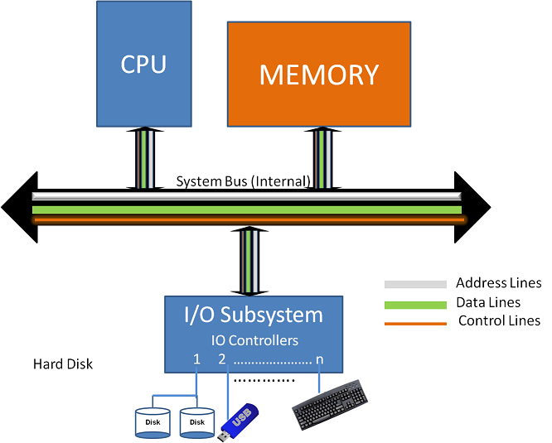
Lecture
SLIDE 6 / 10
Design of a Basic Computer
1
A basic computer consists of a CPU, memory, and input/output interfaces
2
The CPU contains a control unit and an arithmetic logic unit
3
Memory stores both instructions and data in a unified address space
4
The control unit decodes instructions and generates control signals for execution
5
Data flows between registers, memory, and I/O devices via a bus
Source: res.cloudinary.com
Chandigarh University
6 / 10
Notes:
A basic computer consists of a CPU, memory, and input/output interfaces. The CPU contains a control unit and an arithmetic logic unit to process data. Memory stores both instructions and data in a unified address space. The control unit decodes instructions and generates control signals for execution. Data flows between registers, memory, and I/O devices via a shared bus.

Slide 7
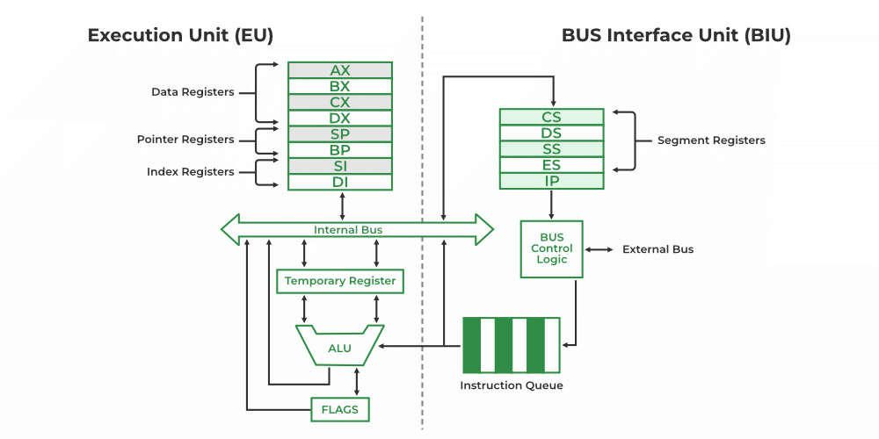
Lecture
SLIDE 7 / 10
General Register Organization
1
General register organization allows any register to be used as an operand
2
This flexibility simplifies instruction set design and compiler optimization
3
Registers are faster than main memory for storing intermediate results
4
A typical design includes eight or sixteen general-purpose registers
5
The accumulator is a special register often used for arithmetic operations
Source: media.geeksforgeeks.org
Chandigarh University
7 / 10
Notes:
General register organization allows any register to be used as an operand. This flexibility simplifies instruction set design and compiler optimization significantly. Registers are faster than main memory for storing intermediate results. A typical design includes eight or sixteen general-purpose registers. The accumulator is a special register often used for arithmetic operations.

Slide 8
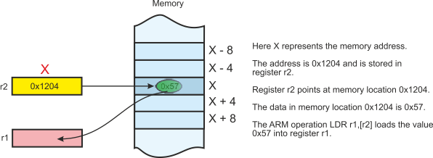
Worked Example
SLIDE 8 / 10
Effective Address Calculation
GOVERNING EQUATION
Given instruction ADD R1, [100] with base register R2 = 50
DIRECT ADDRESSING
Effective Address = 100 (operand at memory location 100)
INDEXED ADDRESSING
Effective Address = 100 + R2 = 100 + 50 = 150
INDIRECT ADDRESSING
Effective Address = Content of memory location 100
• If memory[100] = 200, then operand is at address 200
Source: alanclements.org
Chandigarh University
8 / 10
Notes:
Let us calculate the effective address for a specific instruction. Given instruction ADD R1, [100] with base register R2 = 50. In direct addressing, the effective address is simply 100. In indexed addressing, we add the base register value: 100 + 50 = 150. If we use indirect addressing, the effective address is the content of memory location 100, which might be 200.

Slide 9

Lecture
SLIDE 9 / 10
Key Takeaways
1
Addressing modes determine how operands are located and accessed by the CPU
2
Immediate and register modes are faster than direct and indirect modes
3
General register organization provides flexibility for efficient instruction execution
4
The basic computer design integrates CPU, memory, and I/O via a bus
5
Understanding these concepts is essential for analyzing instruction set architecture
Source: www.slideteam.net
Chandigarh University
9 / 10
Notes:
To summarize, addressing modes determine how operands are located and accessed by the CPU. Immediate and register modes are generally faster than direct and indirect modes. General register organization provides flexibility for efficient instruction execution. The basic computer design integrates CPU, memory, and I/O via a bus. Understanding these concepts is essential for analyzing instruction set architecture.

Slide 10
Lecture
SLIDE 10 / 10
References
COMPUTER ORGANIZATION AND DESIGN
The Hardware/Software Interface — David A. Patterson, John L. Hennessy
COMPUTER ARCHITECTURE
A Quantitative Approach — John L. Hennessy, David A. Patterson
• Computer Organization and Architecture — William Stallings
• Computer System Architecture — M. Morris Mano & Rajib Mall
• Computer Organization — Carl Hamacher, Zvonko Vranesic, Safwat Zaky
Chandigarh University
10 / 10
Notes:
For further reading, please refer to the standard textbooks listed here. William Stallings and M. Morris Mano provide excellent foundational knowledge. Carl Hamacher and the works by Patterson and Hennessy offer deeper insights into hardware-software interfaces. These resources will support your analysis of register organization and instruction set architecture.

